Slide 1

TravelTide Customer Retention Strategy
by Jamunadevi Balamurugan

Slide 2
“Book the journey,
live the story.”

Slide 3
Project Objective
Improve customer retention for TravelTide by designing a personalized rewards program based on user behaviour and demographics.

Slide 4
DB schema
Users - Dim
user_id
Hotels - Dim
Sessions - Fact
trip_id
user_id
trip_id
Flights - Dim
trip_id

Slide 5
Data Preparation
Quality checks & Cleaning(Handled null values,remove duplicates)
Aggregation& Merging(agg behavioural metrics to user level,merged data using SQL joins and CTEs)
Filters (more than 7 sessions, session start>2023-01-04

Slide 6
Feature Engineering
Average Kilometres travelled(using Haversine formula)
Average nights stayed
Trips per session
Cancellation rate
Booking lead time
clicks per session
Final dataset: 5998 rows(users) for downstream modelling

Slide 7
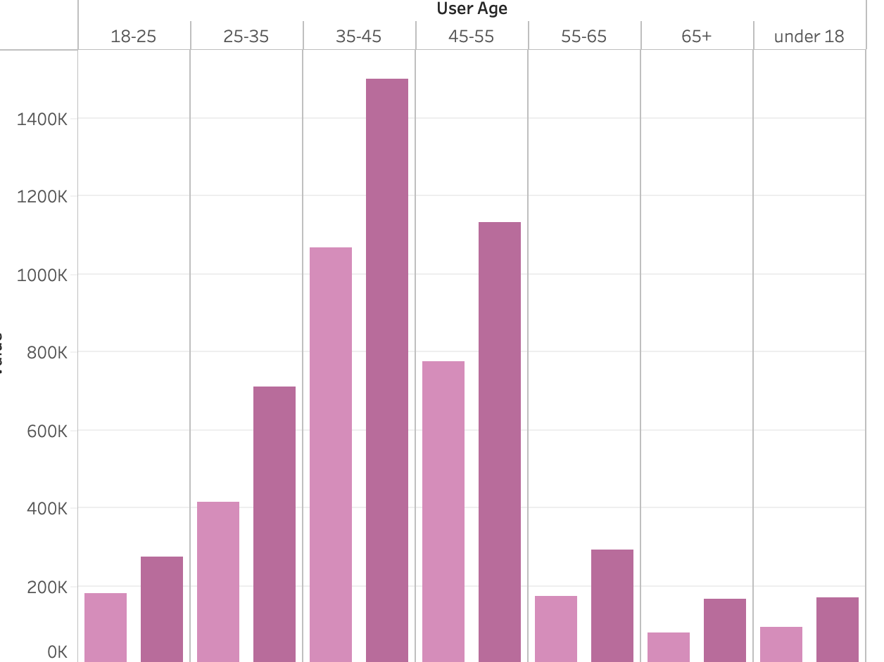
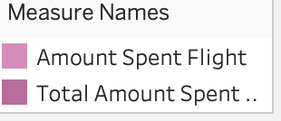
Key Insights
Users spend more on Hotels than flights
Amount spent on flight
Amount spent on hotel

Slide 8
Key Insights
Higher travel distance are common among high value segments

Slide 9
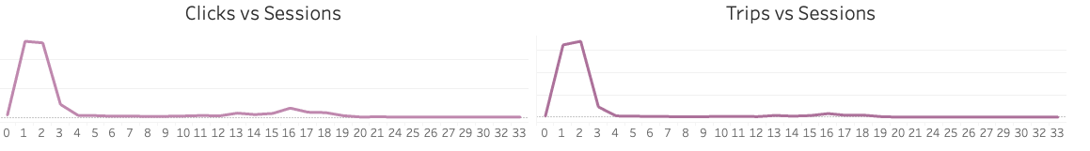
Key Insights
Longer session times to reduce trips frequency and clicks

Slide 10
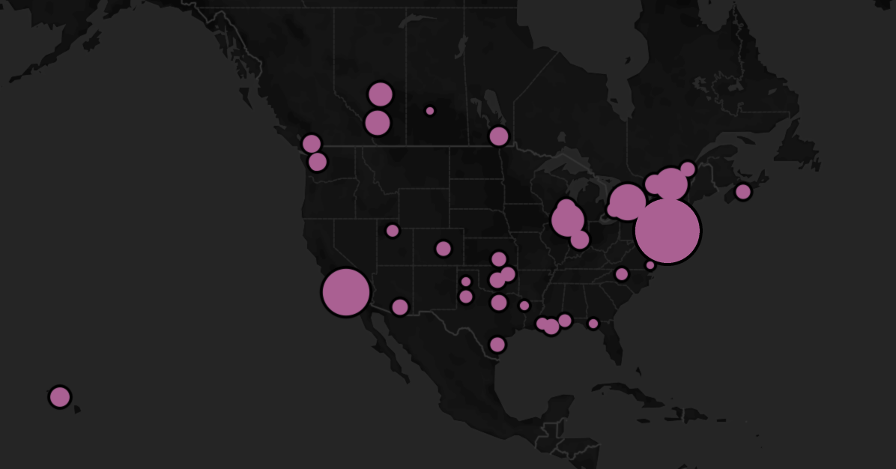
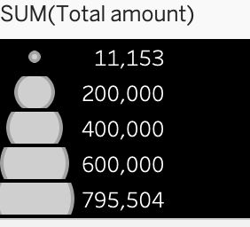
Key Insights
New York City is the top revenue city

Slide 11
Customer Segmentation(Composite Score Method)
Loyalty Score
Profitability Score
Engagement Score
Premium Traveller Score
Composite Score = w1x1+w2x2+w3x3+w4x4
Segmented customers by percentile ranks

Slide 12
Composite Score Method
Advantages of composite score segmentation
Tailored to specific business goals: retention, engagement, profitability
Broader scope than traditional RFM segmentation
Suitable for machine learning models
Enables accurate targeting of loyalty initiatives

Slide 13
Perk Assignment Strategy
Shifted from fixed perks to personalized ,segment-specific rewards based on behaviour and preferences

Slide 14
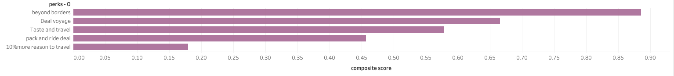
Composite scores of Perks

Slide 15
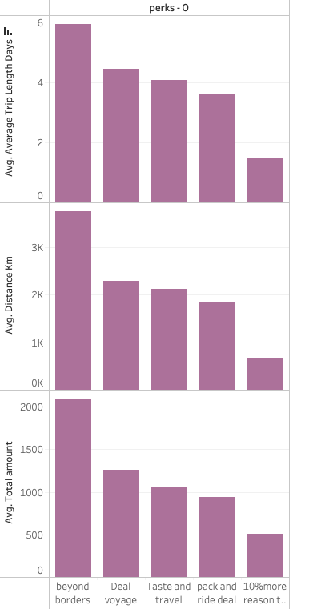
Perk vs Monetary values

Slide 16
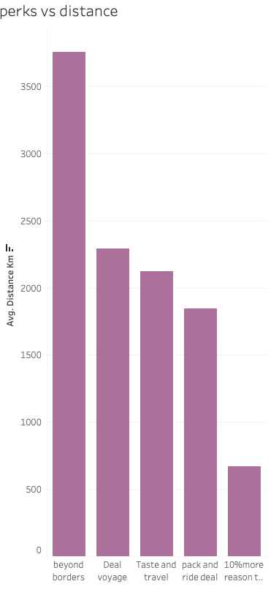
Perk vs. Distance

Slide 17
Segment | Perk options
Beyond borders | Discounted fares for children or 25% off hotel booking
Deal Voyage | One hotel night free or discounted travel protection policies
Taste and Travel | Pay monthly without interest or free hotel meal
Pack and Ride Deal | Free luggage or 25% off city bus service
10% more reason to travel | 10% off next hotel booking or 10% off car rentals

Slide 18
Recommendations
Improve booking UX to reduces session time and increase conversions
Enhance hotel-related perks, especially for the high spend users.
Focus on high-revenue regions like New York for premium service expansions.
Use machine learning for perk prediction and A/B testing for validation.
Deconstruct user behaviour for search-> click-> book friction points

Slide 19
Thank you!

